Slide 1
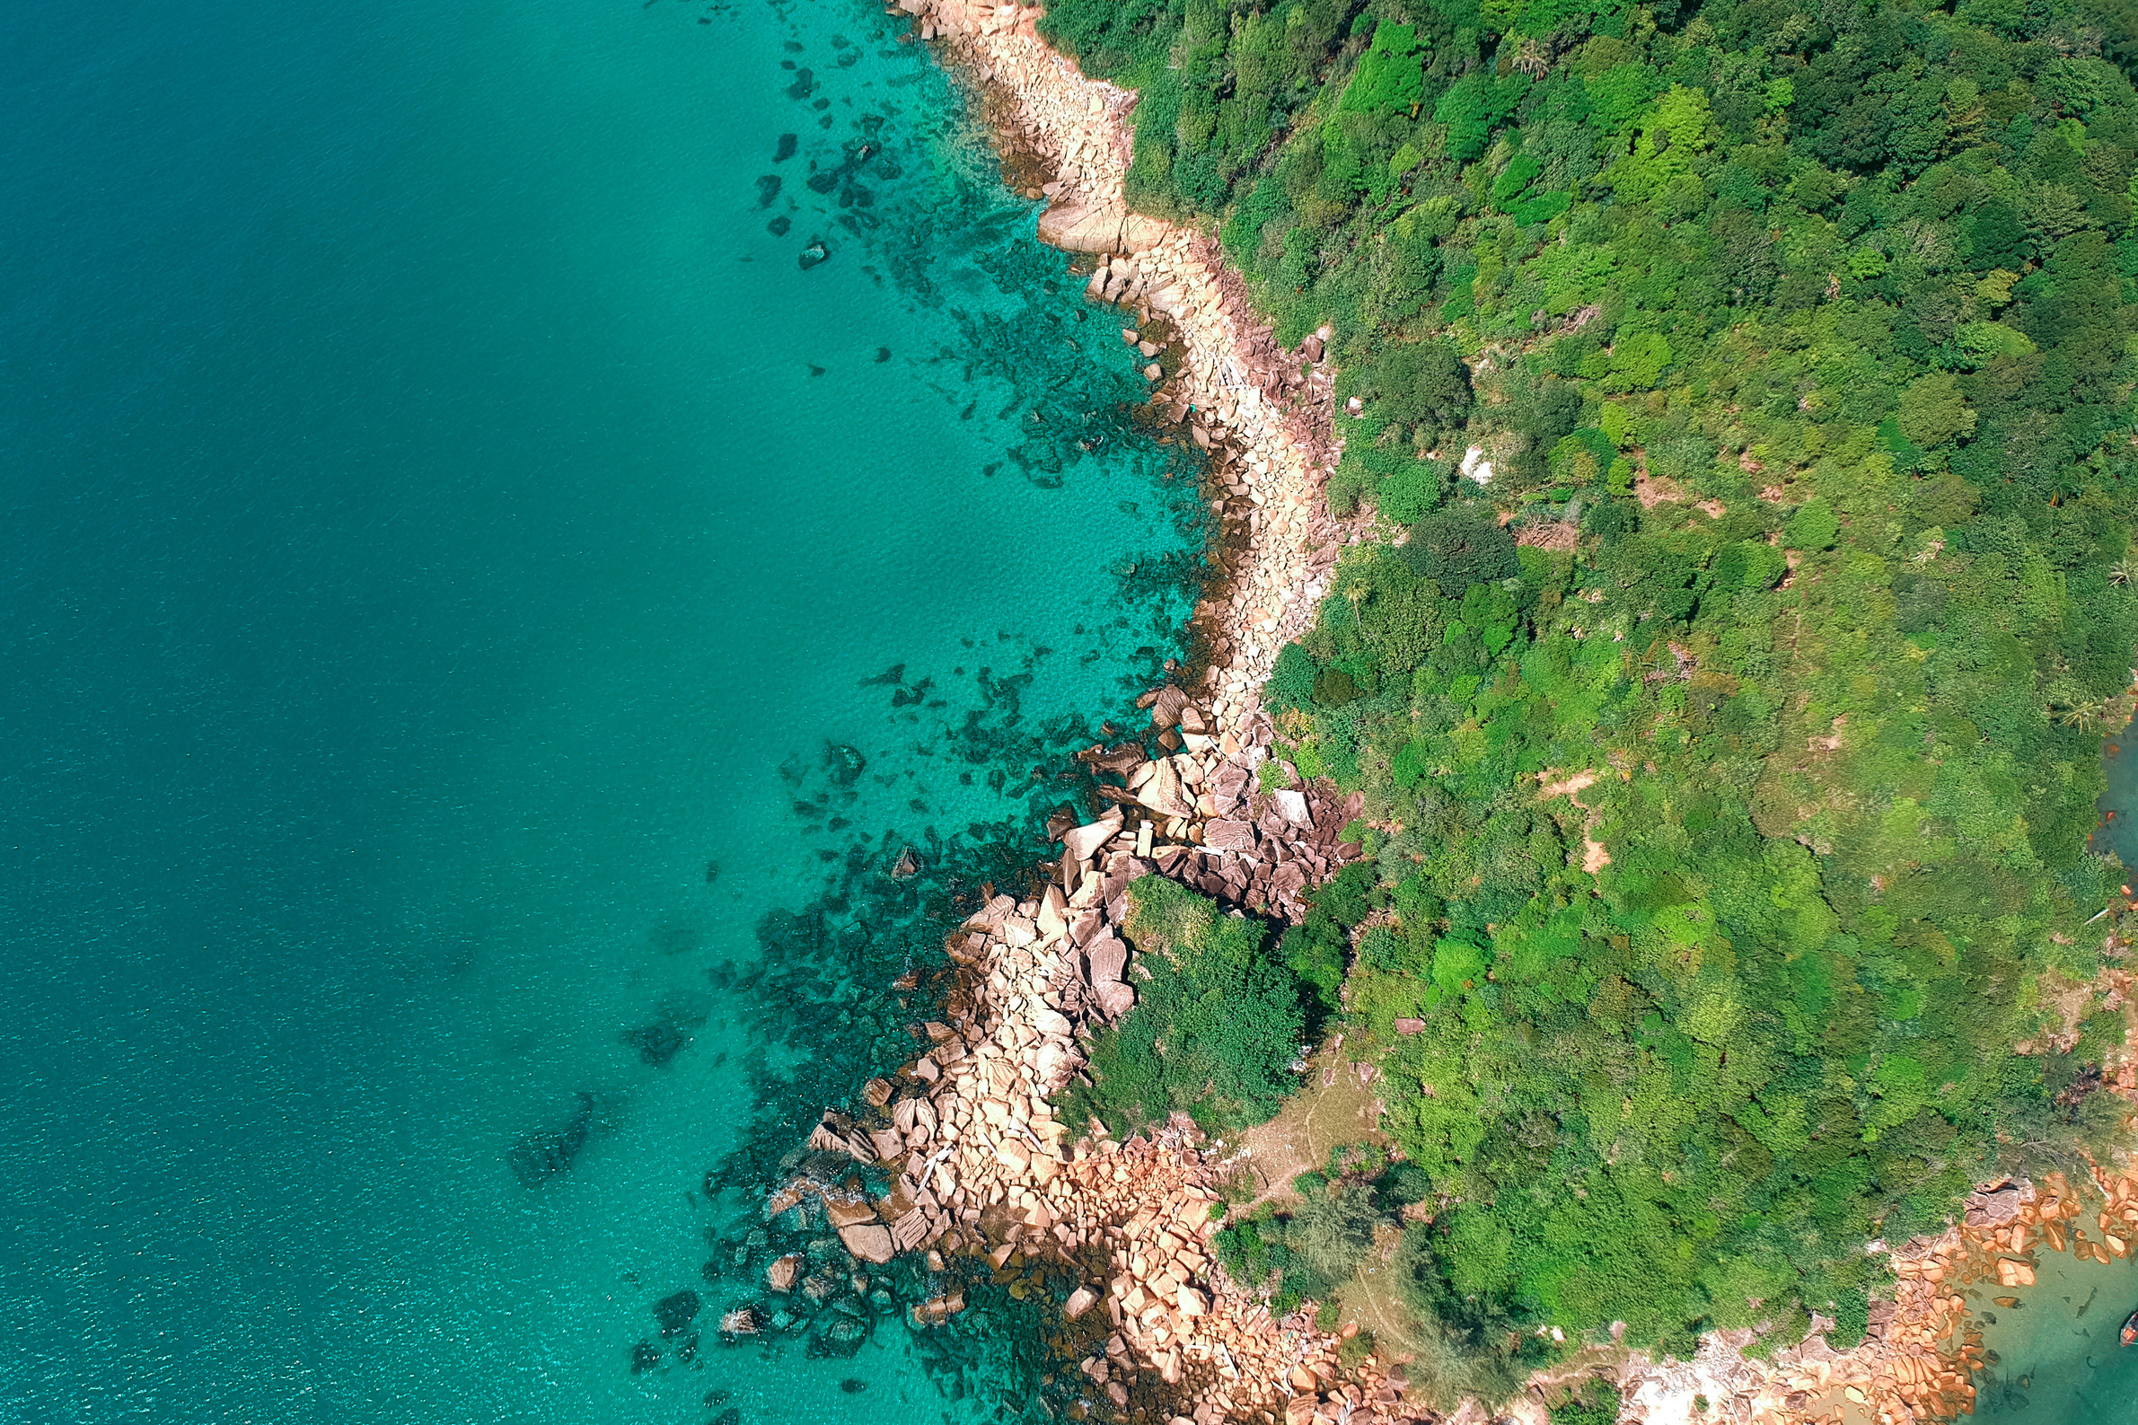

"Fin-tastic Journeys: Shark Eco Tours"
preserve the sharks, one dive at a time
Inês Bettencourt
Oeendrila L Gerold
Jan Gfeller
Enrique Milans

Slide 2
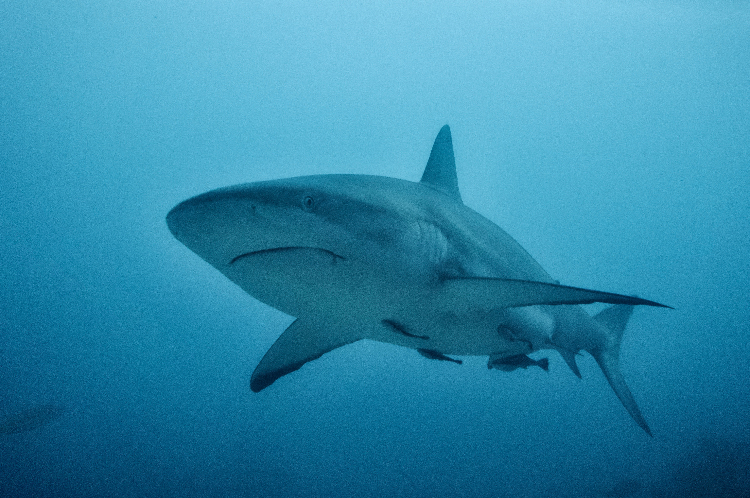
Contents
01 Project Overview
02 Data Wrangling and Cleaning
03 Exploratory Data Analysis
04 Major Obstacles
05 Conclusions

Slide 3




PROJECT OVERVIEW: Original Dataset and Hypothesis
1. The OG dataset was messy !
.
2. The underlying central theme of shark-human interactions became our working hypothesis for an awareness and conservation oriented plan.
3. With some secondary research we decided on shark ecotourism
Notes:
point no 3: We were sure that the dataset could help us understand the nature of shark attacks, both provoked and unprovoked, identify hostile and non-hostile species, and assess endangered shark populations based on secondary research. This, in turn, could help determine significant issues and suitable entry points for an eco-tourism business model

Slide 4
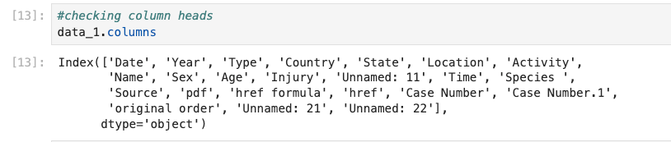

II. Project overview: Being creative and effective
1.New Dataframe
Year
Type
Country
State
Injury
Species
2.Data Standardisation
Column names snake_case
adjusting data types
drop nans
drop duplicates
3. Data Cleaning by Column:
Year: limiting data set to last 25 years based on global warming and modern tourism
State and country: kept duplicates, cleaned irregularities
Species: Created types
Type: Created and dropped the “unwanted category”= "Invalid," "Watercraft," "Sea Disaster," "Under Investigation," "Unconfirmed,"
Retained "Provoked" and "Unprovoked”
Injury: new categories ---> lacerations, minor injuries, major injuries, fat, probably scavenging, and material damage
Notes:
Structure and process of data cleaning and analysis
1. we looked at the columns and could immediately form a new dataframe with our requirements. This saved time and effort.
2. provide justifications for retained columns

Slide 5
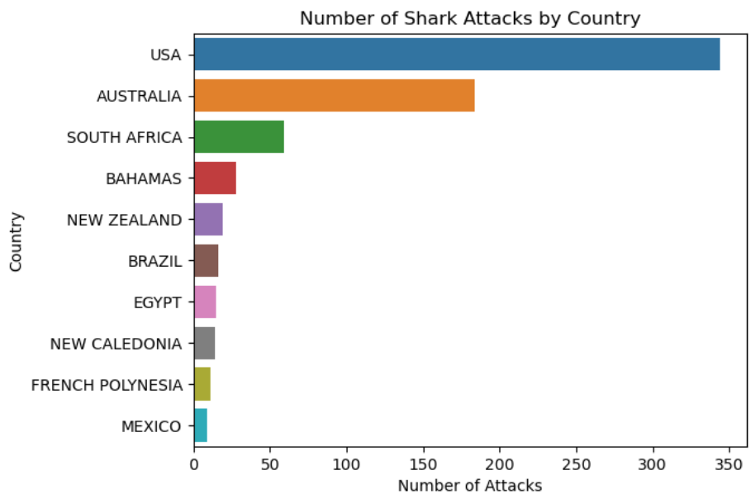

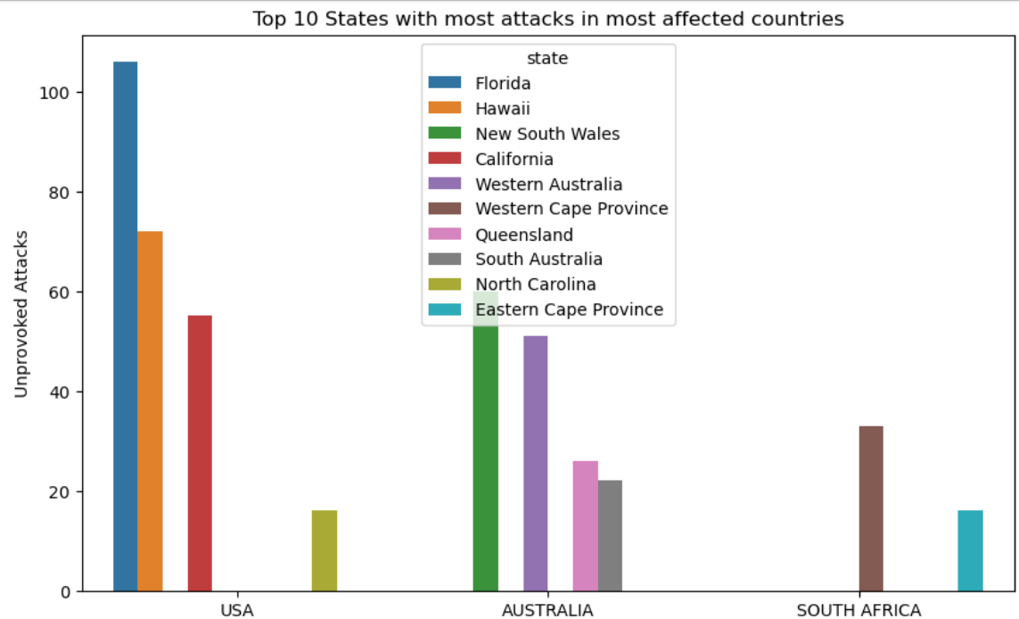
03 Exploratory Data Analysis

Slide 6
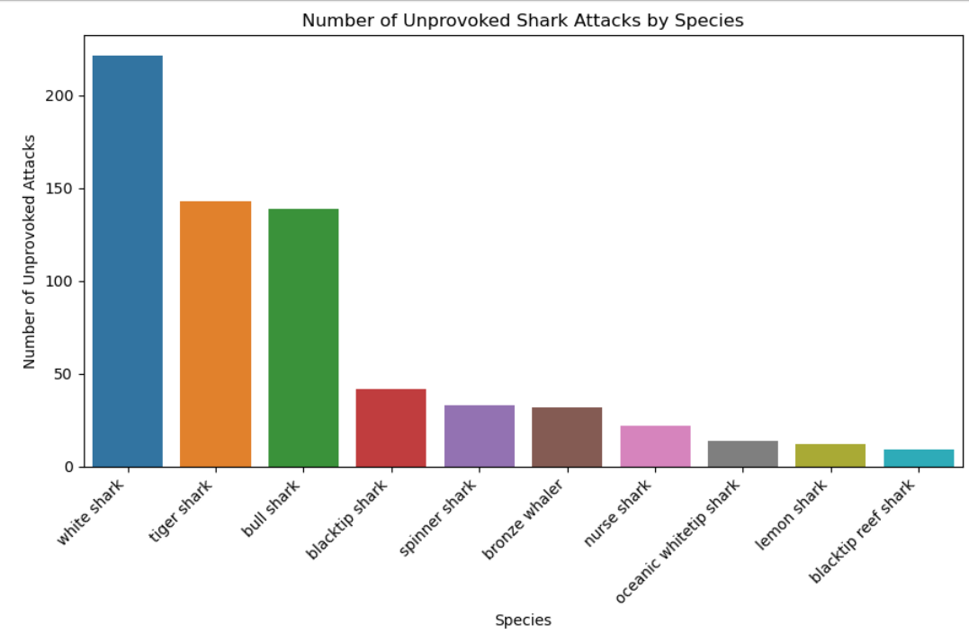
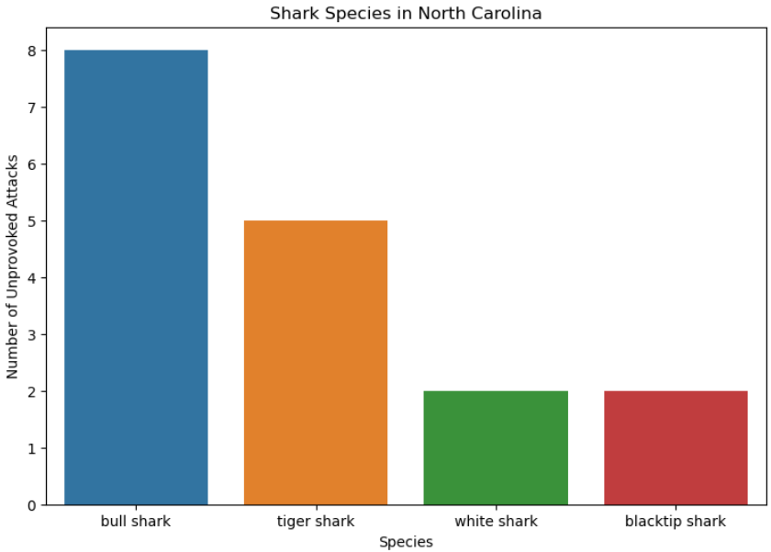

Slide 7
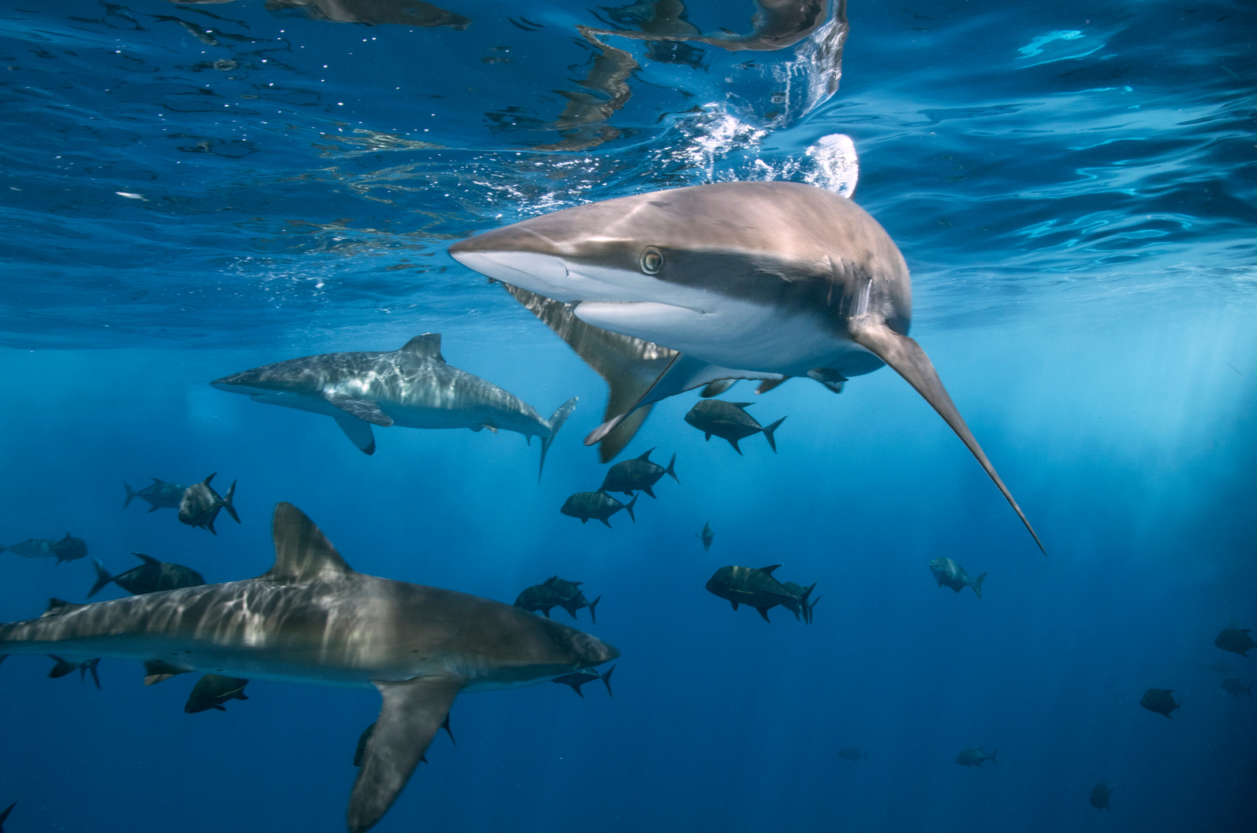
The Blacktip Shark
Status: Vulnerable, caught in large numbers by commercial fisheries
Nature: Wary of humans, but aggressive in presence of food
Attacks:
Unprovoked fatal attacks: 0
Unprovoked non-fatal attacks: 35
Notes:
Our business will focus on the blacktip shark since the white, tiger and bull sharks are the “Big Three” in the shark attack world because they are large species that are capable of inflicting serious injuries to a victim, are commonly found in areas where humans enter the water, and have teeth designed to shear rather than hold.
source:
(https://www.floridamuseum.ufl.edu/shark-attacks/factors/species-implicated/)

Slide 8


Major Obstacle

Slide 9
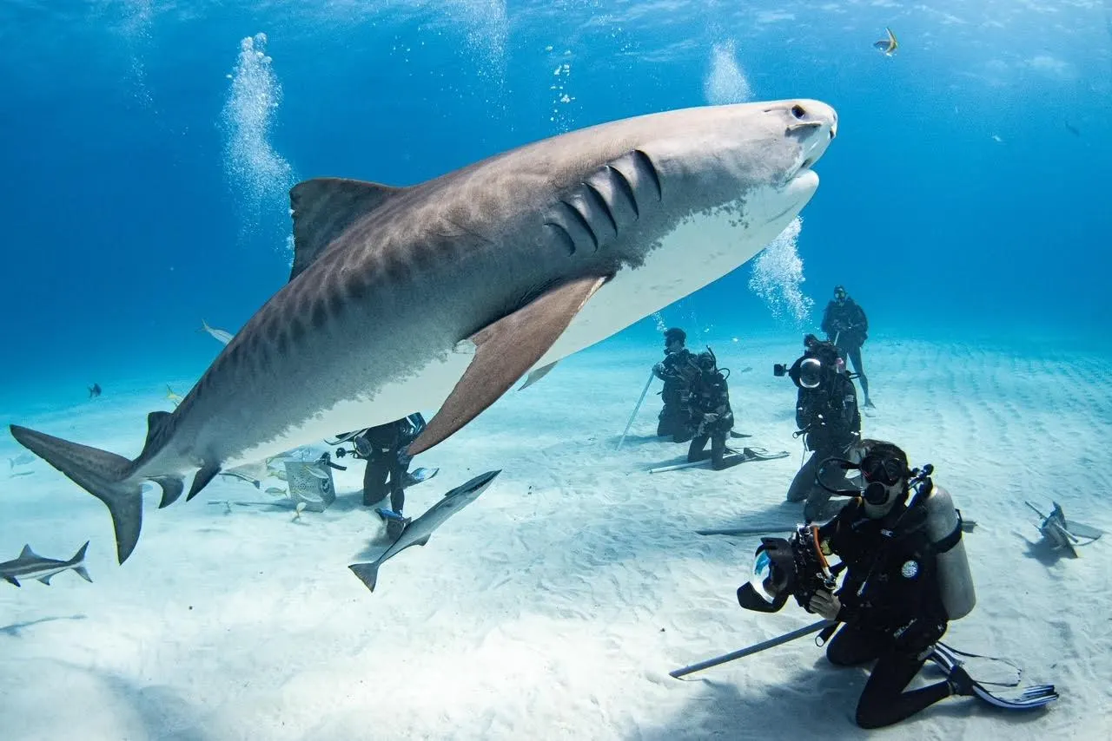

CONCLUSION
Shark Ecotourism
Notes:
North Carolina data source :https://www.unc.edu/discover/the-past-present-and-future-of-shark-research/

Slide 10
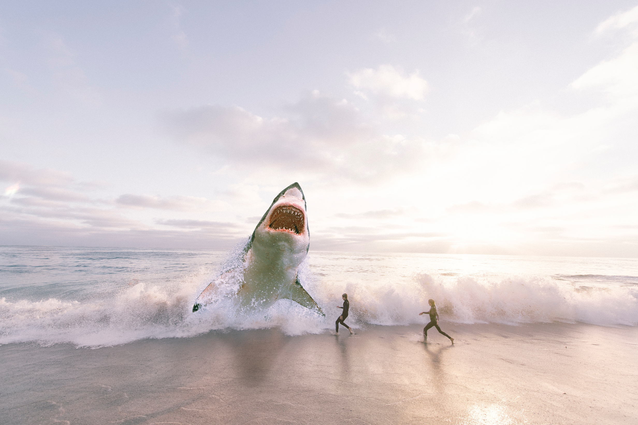

THANK
YOU!

